Slide 1
Fixed Axis Rotation in Rigid Bodies (Scalar Notation)
Dr. Jacob Moore
Associate Professor of Engineering
Penn State Mont Alto

Slide 2
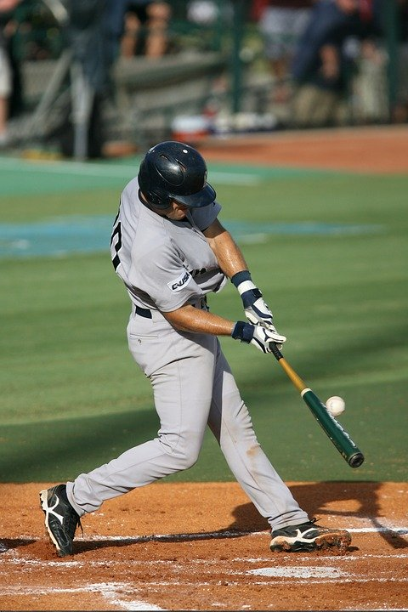
Rigid Body Kinematics
So far, we have talking about particles, where we are only concerned with the location, velocity, and acceleration of the particle.
If now we are going to start talking about rigid bodies, where we will be concerned with the orientation, angular velocity, and angular acceleration of the object as well.

Slide 3
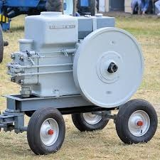
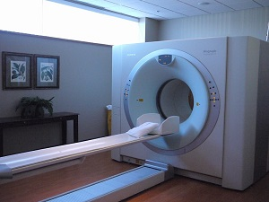
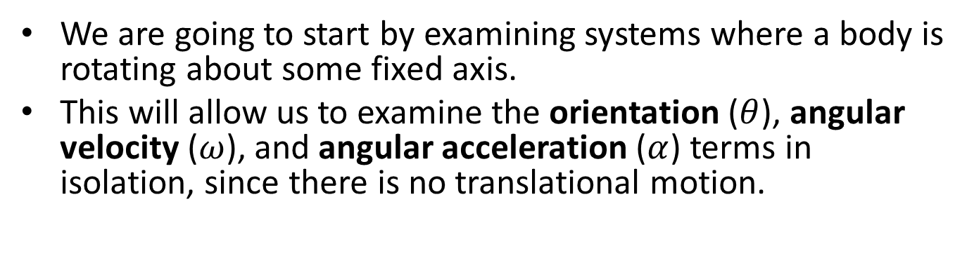
Fixed Axis Rotation
We are going to start by examining systems where a body is rotating about some fixed axis.
This will allow us to examine the orientation ($θ$), angular velocity ($ω$), and angular acceleration ($α$) terms in isolation, since there is no translational motion.

Slide 4
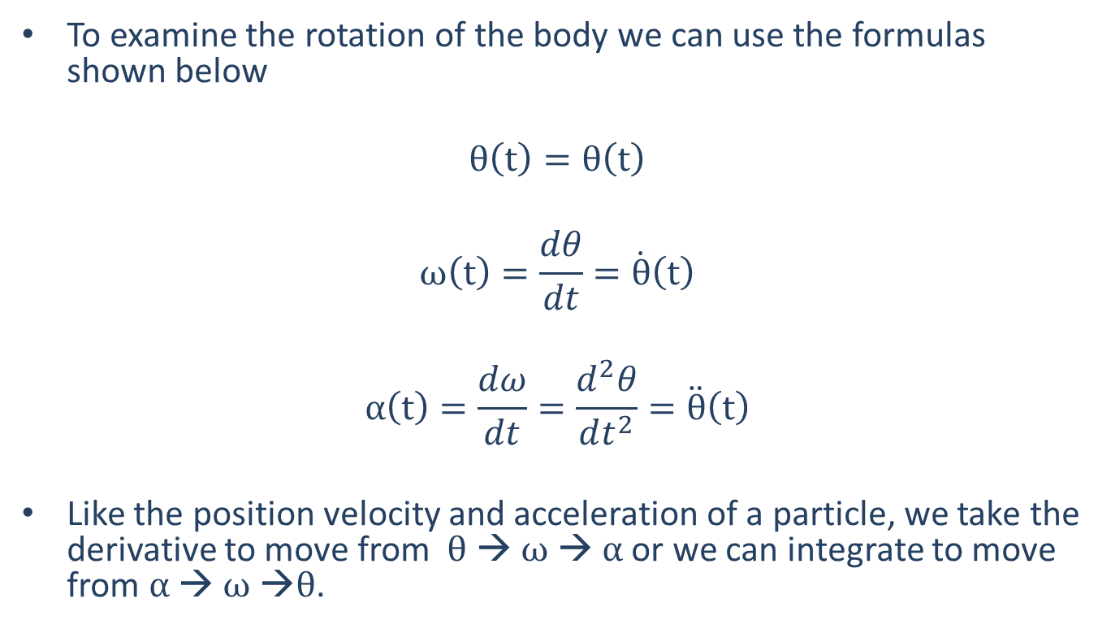
Fixed Axis Rotation
To examine the rotation of the body we can use the formulas shown below
$$θ\left(t\right)=θ\left(t\right)$$
$$ω\left(t\right)=\frac{dθ}{dt}=\dot{θ}\left(t\right)$$
$$α\left(t\right)=\frac{dω}{dt}=\frac{d^{2}θ}{dt^{2}}=\ddot{θ}\left(t\right)$$
Like the position velocity and acceleration of a particle, we take the derivative to move from $θ$ → $ω$ → $α$ or we can integrate to move from $α$ → $ω$ →$θ$.

Slide 5
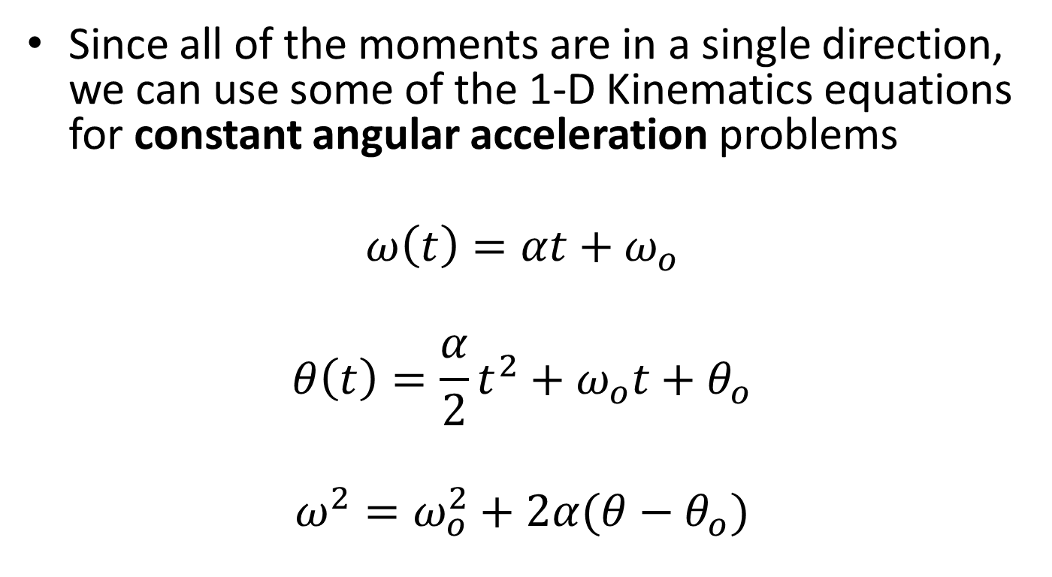
Fixed Axis Rotation
Since all of the moments are in a single direction, we can use some of the 1-D Kinematics equations for constant angular acceleration problems
$$ω\left(t\right)=αt+ω_{o}$$
$$θ\left(t\right)=\frac{α}{2}t^{2}+ω_{o}t+θ_{o}$$
$$ω^{2}=ω_{o}^{2}+2α(θ−θ_{o})$$

Slide 6


Planar Motion and the Direction of Rotation
Translation
(rectangular)
$r\left(t\right)= x\left(t\right)\hat{i}+y\left(t\right)$ $\hat{j}$
$$v\left(t\right)= \dot{x}\left(t\right)\hat{i}+\dot{y}\left(t\right)\hat{j}$$
$$a\left(t\right)= \ddot{x}\left(t\right)\hat{i}+\ddot{y}\left(t\right)\hat{j}$$
Rotation
$$θ\left(t\right)=θ\left(t\right)\hat{k}$$
$$ω\left(t\right)=\dot{θ}\left(t\right)\hat{k}$$
$$α\left(t\right)=\ddot{θ}\left(t\right)\hat{k}$$
Similar to the way moments work, the axis of rotation, along with the right hand rule indicates the “direction” of the rotation.

Slide 7

Motion of a Point in Fixed Axis Rotation
Any point on the record will have a velocity and acceleration
The record as a whole is being rotated about a fixed point
As we look at motion about a fixed axis, the material on the axis of rotation is not moving, but all points not on the axis of rotation are moving.
To discuss the motion of a point on a rotating body, we will use polar coordinates and borrow some of the analysis we have done earlier.

Slide 8
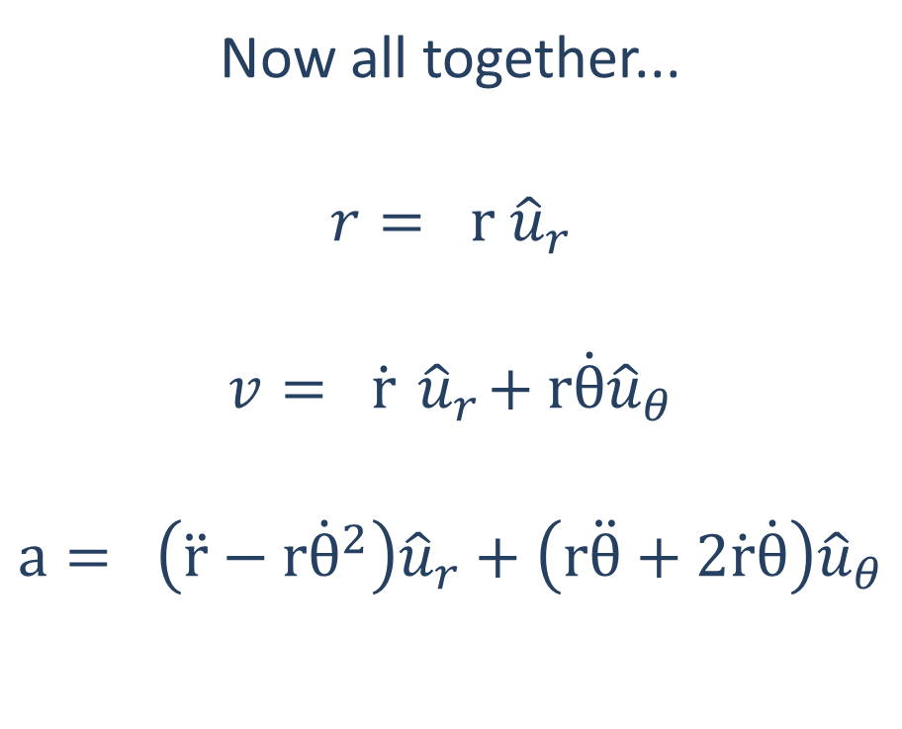
Polar Coordinates Motion (Review)
Now all together...
$$r= r {\hat{u}}_{r}$$
$$v= \dot{r}{ \hat{u}}_{r}+r\dot{θ}{\hat{u}}_{θ}$$
$$a= \left(\ddot{r}−r{\dot{θ}}^{2}\right){\hat{u}}_{r}+\left(r\ddot{θ}+2\dot{r}\dot{θ}\right){\hat{u}}_{θ}$$

Slide 9



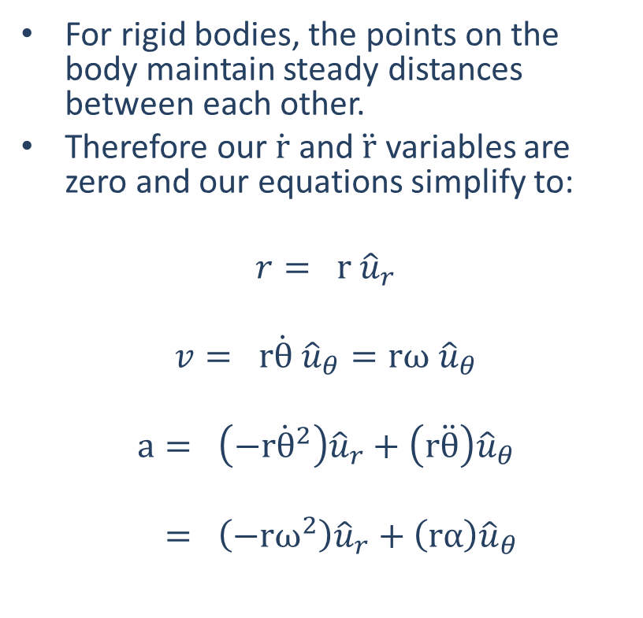




Velocity and Acceleration of a Point in Fixed Axis Rotation
For rigid bodies, the points on the body maintain steady distances between each other.
Therefore our $\dot{r}$ and $\ddot{r}$ variables are zero and our equations simplify to:
$$r= r {\hat{u}}_{r}$$
$$v= r\dot{θ} {\hat{u}}_{θ}=rω {\hat{u}}_{θ}$$
$$a= \left(−r{\dot{θ}}^{2}\right){\hat{u}}_{r}+\left(r\ddot{θ}\right){\hat{u}}_{θ}$$
$= \left(−rω^{2}\right){\hat{u}}_{r}+\left(rα\right){\hat{u}}_{θ}$
$$\ddot{θ}$$
$$r$$
$$P$$
$$\dot{θ}$$
$${\hat{u}}_{θ}$$
$${\hat{u}}_{r}$$
$$O$$

Slide 10




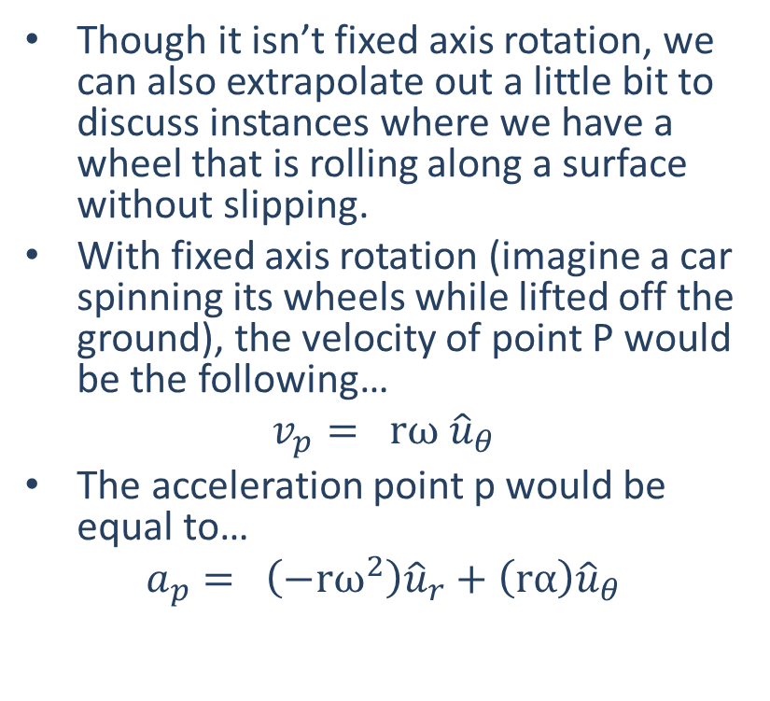


Rolling Without Slipping
Though it isn’t fixed axis rotation, we can also extrapolate out a little bit to discuss instances where we have a wheel that is rolling along a surface without slipping.
With fixed axis rotation (imagine a car spinning its wheels while lifted off the ground), the velocity of point P would be the following…
$$v_{p}= rω {\hat{u}}_{θ}$$
The acceleration point p would be equal to…
$$a_{p}= \left(−rω^{2}\right){\hat{u}}_{r}+\left(rα\right){\hat{u}}_{θ}$$
$$ω or \dot{θ}$$
$$C$$
$${\hat{u}}_{θ}$$
$$P$$
$${\hat{u}}_{r}$$

Slide 11
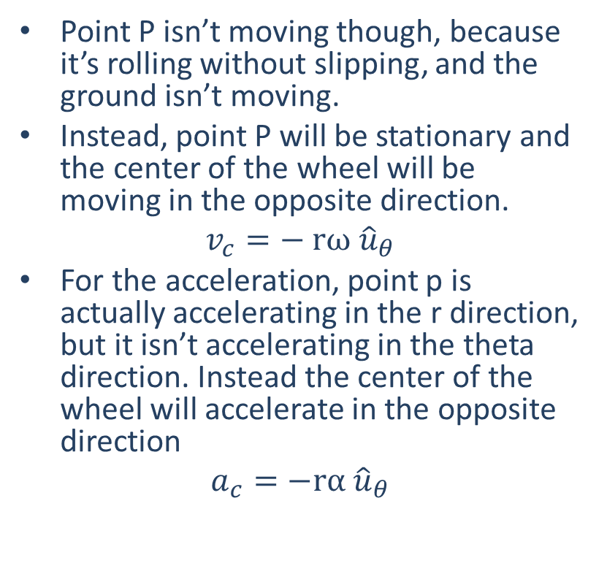
Rolling Without Slipping
Point P isn’t moving though, because it’s rolling without slipping, and the ground isn’t moving.
Instead, point P will be stationary and the center of the wheel will be moving in the opposite direction.
$$v_{c}=− rω {\hat{u}}_{θ}$$
For the acceleration, point p is actually accelerating in the r direction, but it isn’t accelerating in the theta direction. Instead the center of the wheel will accelerate in the opposite direction
$$a_{c}=−rα{ \hat{u}}_{θ}$$
$$ω or \dot{θ}$$
$$C$$
$${\hat{u}}_{θ}$$
$$P$$
$${\hat{u}}_{r}$$

Slide 12
Thanks for Watching
See other engineering mechanics videos and access the full tool at…

Slide 13
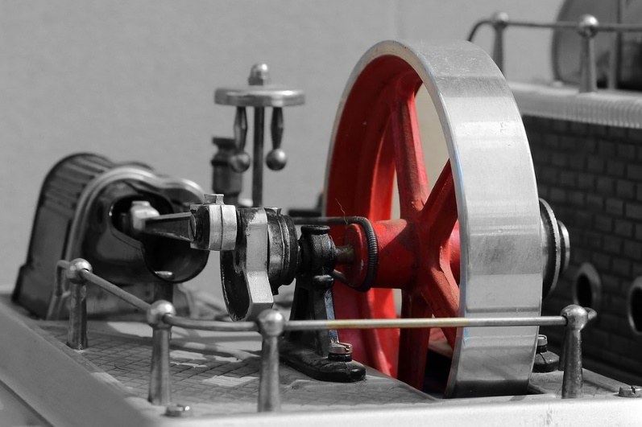
Fixed Axis Rotation Worked Example
A flywheel on a fixed axel is rotating at a rate of 600 rpm. A brake then decelerates the flywheel at a rate of 30 rad/s² until stopping.
What is the time required to stop the flywheel?
How many rotations does the flywheel go through while decelerating?

Slide 14

Worked Example
An 8cm hard drive platter is spinning at 3600 rpm. What is the velocity of a point on the edge of the platter?
What is the acceleration of a point on the edge of the hard drive platter?

